Slide 1
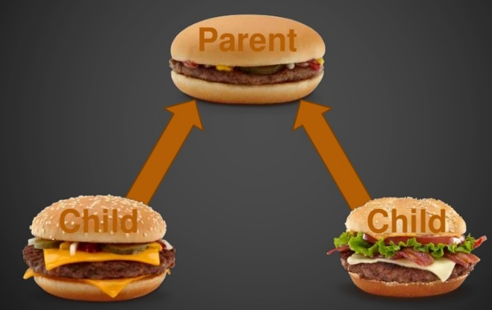
INHERITANCE
Understanding Inheritance

Slide 2
Agenda & Reading
Topics:
Introduction
Inheritance
Constructors
public, private & protectedMethod Overriding
The Object class
Reading
Java how to program Late objects version (D & D)
Chapter 9
The Java Tutorial :
https://docs.oracle.com/javase/tutorial/java/IandI/subclasses.html
Multiple Inheritance of State, Implementation, and Type
Overriding and Hiding Methods
Polymorphism
Hiding Fields
Using the Keyword super
Object as a Superclass
Writing Final Classes and Methods

Slide 3
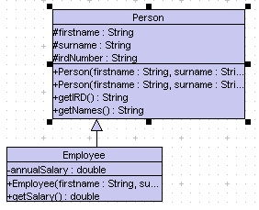
1.Introduction
Inheritance
A new class is created by acquiring an existing class’s members and possibly embellishing them with new or modified capabilities.
Existing class is called the superclass/base
New class is called the subclass/derived
Can save time during program development by basing new classes on existing proven and debugged high-quality software.
Increases the likelihood that a system will be implemented and maintained effectively.
The former, known as derived classes, take over (or inherit) attributes and behaviour of the latter, which are referred to as base classes.
Example: Person & Employee
getSalary() –
Additional method
getIRD(), getNames():
inherit from Person

Slide 4
1.Introduction Inheritance
When creating a class, rather than declaring completely new members, you can designate that the new class
should inherit the members of an existing class
adds its own variables and methods
can change the meaning of inherited methods that are specific to the subclass.
A subclass is more specific than its superclass and represents a more specialized group of objects.
Every class in Java extends (or “inherits from”) Object implicitly.
A subclass can be a superclass of future subclasses.
Java supports only single inheritance, in which each class is derived from exactly one direct superclass.

Slide 5
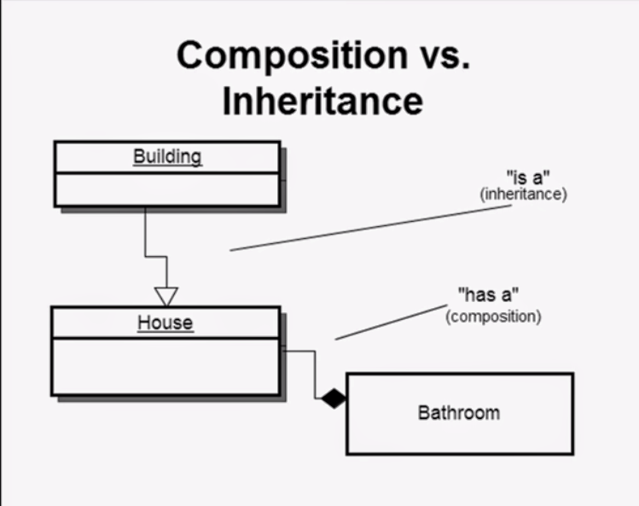
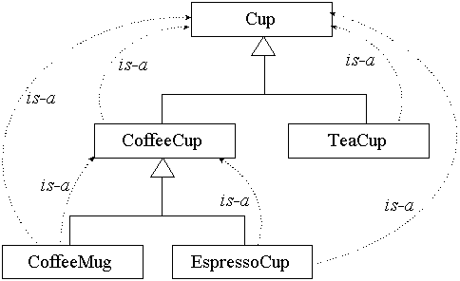
1.Introduction Has-a Vs is-a relationship
We distinguish between the is-a relationship and the has-a relationship
Is-a represents inheritance
In an is-a relationship, an object of a subclass can also be treated as an object of its superclass
Has-a represents composition
In a has-a relationship, an object contains as members references to other objects

Slide 6
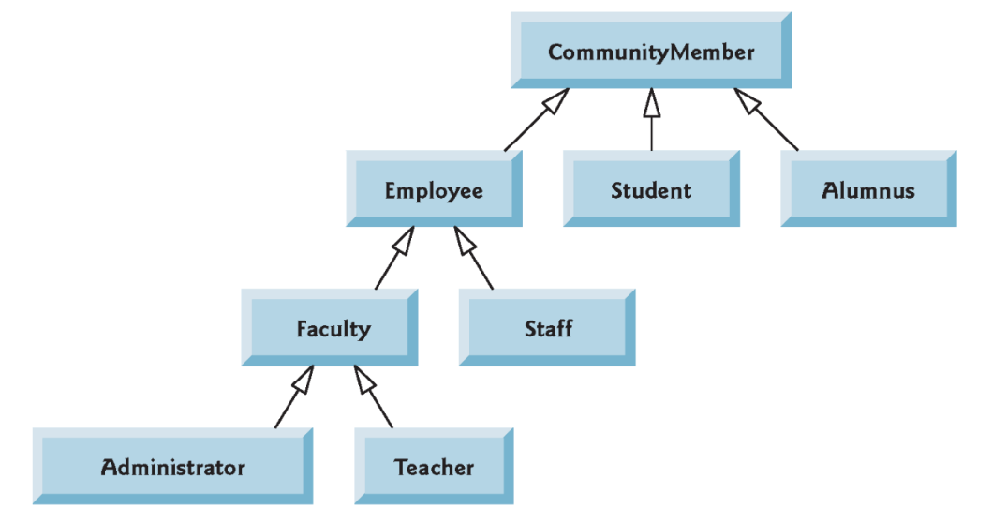
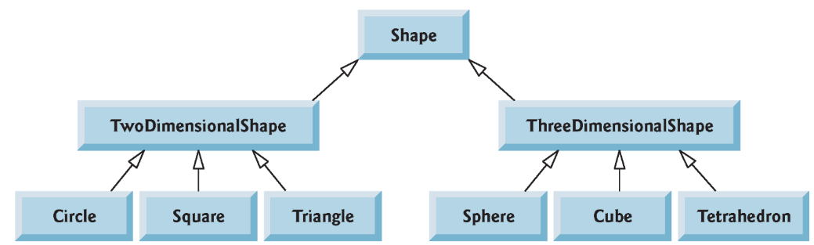
1.Introduction Superclasses and Subclasses
A superclass exists in a hierarchical relationship with its subclasses.
Each arrow in the hierarchy represents an is-a relationship
Starting from the bottom, you can follow the arrows and apply the is-a relationship up to the topmost superclass.
A Triangle is a TwoDimensionalShape and is a Shape
A Sphere is a ThreeDimensionalShape and is a Shape.

Slide 7
2.Inheritance
Inheritance issue
A subclass can inherit methods that it does not need or should not have.
Even when a superclass method is appropriate for a subclass, that subclass often needs a customized version of the method.
The subclass can override (redefine) the superclass method with an appropriate implementation.
For example: Sphere & ColoredSphere
The Sphere class is a base class
Instance Variable: radius
Instance Methods: setRadius(…), diameter(), area(), circumference(), toString() …
public class Sphere {
protected double theRadius;
public Sphere() {
setRadius(1.0);
}
...
}

Slide 8
2.Inheritance Example: Sphere & ColoredSphere
The ColoredSphere is a derived class that
Inherits a field (radius) from the base class,
Inherits a few methods (setRadius, diameter … etc) from the base class,
Adds a new field: color
Adds two new methods: setColor, getColour
Overrides an existing method (toString) from the base class.
public class ColoredSphere extends Sphere {
private Color color;
public ColoredSphere(Color c) {
super();
color = c;
}
public Color getColor() {...}
public String toString() {
return super.toString() + ...}
...
}
Radius = 5.0, Colour=java.awt.Color[r=255,g=255,b=255]
The ball color is java.awt.Color[r=255,g=255,b=255]
ColoredSphere ball = new ColoredSphere(Color.white, 5);
System.out.println(ball);
System.out.println("The ball color is " + ball.getColor());

Slide 9
3.Constructors
B1.java
Instantiating a subclass object begins a chain of constructor calls
Each Subclass constructor must always call the superclass constructor (explicitly or implicitly)
Implicitly: calls its superclass default no-argument constructor if the code does not include an explicit call to the superclass constructor
Explicitly: using super()
If you call the superclass constructor explicitly, then the compiler will not call it implicitly.
class A1 {
int x;
public A1() {
x=1;
System.out.println("called A1()");
}
public A1(int x) {
this.x = x;
System.out.println("called A1(x)");
}
}
3
Calls constructor implicitly
class B1 extends A1 {
int y;
public B1() {
System.out.println("called B1()");
}
public B1(int x, int y) {
super(x);
this.y = y;
System.out.println("called B1(x,y)");
}
}
2
4
Calls constructor explicitly
called A1()
called B1()
1
B1 b1 = new B1();
B1 b2 = new B1(10, 100);
called A1(x)
called B1(x,y)

Slide 10
3.Constructors
B2.java
A subclass cannot inherit constructors from the base class. Each subclass should define its constructor
If no constructor is defined, the compiler adds a single zero-parameter default constructor for the class and applies the default initialization for any data fields.
class A1 {
int x;
public A1() {
x=1;
System.out.println("called A1()");
}
public A1(int x) {
this.x = x;
System.out.println("called A1(x)");
}
}
class B2 extends A1 {
int y = 10;
}
Add a single zero-parameter default constructor
3
2
Calls base class’s constructor implicitly
B2 b = new B2();
System.out.println("b.x=" + b.x);
System.out.println("b.y=" + b.y);
called A1()
b.x=1
b.y=10
1

Slide 11
3.Constructors
B2.java
A subclass cannot inherit constructors from the base class. Each subclass should define its constructor
If the subclass does not have such a constructor, the compiler would issue an error.
class A1 {
int x;
public A1() {
x=1;
System.out.println("called A1()");
}
public A1(int x) {
this.x = x;
System.out.println("called A1(x)");
}
}
class B2 extends A1 {
int y = 10;
}
B2 b = new B2(10);
Compile time error :
No 1-argument constructor in the subclass

Slide 12
3.Constructors
B2.java
A subclass cannot inherit constructors from the base class. Each subclass should define its constructor
If the subclass does not have such a constructor, the compiler would issue an error.
class A1 {
int x;
public A1() {
x=1;
System.out.println("called A1()");
}
public A1(int x) {
this.x = x;
System.out.println("called A1(x)");
}
}
class B extends A1 {
int y = 10;
public B(int x) {
super(x);
}
}
B b = new B();
Compile time error:
No zero-parameter constructor in the subclass

Slide 13
3.Constructors
B3.java
You can only call a superclass constructor from a subclass constructor, not from any other subclass method
Never place any subclass constructor code ahead of its superclass constructor call (reason: a subclass constructor’s initialisation may depend on the values declared in a superclass)
class A1 {
int x;
public A1() {
x=1;
System.out.println("called A1()");
}
public A1(int x) {
this.x = x;
System.out.println("called A1(x)");
}
}
class B3 extends A1 {
int y = x + 10;
public B3(int x) {
super(x);
}
}
3
2
B3 b = new B3(100);
System.out.println("b.x=" + b.x);
System.out.println("b.y=" + b.y);
1
called A1(x)
b.x=100
b.y=110

Slide 14
4.public, private & protected
Classes, and their fields and methods have access levels to specify how they can be used by other objects during execution
A private field or method is accessible only to the class in which it is defined.
A protected field or method is accessible to the class itself, its subclasses,
A public field or method is accessible to any class of any parentage in any package

Slide 15
4.public, private & protected
A superclass’s private members are hidden from its subclasses
They can be accessed only through the public or protected methods inherited from the superclass
Subclass methods can refer to public and protected members inherited from the superclass simply by using the member names.
When a subclass method overrides an inherited superclass method, the superclass version of the method can be accessed from the subclass by preceding the superclass method name with keyword super and a dot (.) separator

Slide 16
4.public, private & protected
public class Sphere {
protected double theRadius;
public Sphere() {
setRadius(1.0);
}
public Sphere(double r) {...}
public void setRadius(double r) {...}
public double radius() { ... }
public String toString() {...}
...
}
Example:
public class ColoredSphere extends SimpleSphere {
private Color color;
public ColoredSphere(Color c) {
super();
color = c;
}
public void setColor(Color c) { ... }
public Color getColor() {...}
public String toString() {
return super.toString() + ...}
...
public void method1() {
System.out.println(super.theRadius);
}
}

Slide 17
5.Method Overriding
You can change the meaning (override) of the method declared in the superclass
Completely / new implementation , or
Add more functionality to the method
The new method can call the original method in the parent class by specifying “super” before the method name.
Rules:
A Subclass cannot override final methods declared in the base class.
The Overridden method must have the same arguments as the inherited method from the base class.
class Base2 {
public final void finalMethod() {
System.out.println("called Base:finalMethod");
}
}
Example: Derived2.java
public class Derived2 extends Base2 {
public final void finalMethod() {
System.out.println("called Derived:finalMethod");
...
Final methods cannot be overridden.

Slide 18
5.Method Overriding New implementation
Derived.java
To override a superclass method, a subclass must declare a method with the same signature as the superclass method
@Override annotation
Indicates that a method should override a superclass method with the same signature.
If it does not, a compilation error occurs.
This method defined by the subclass is overridden to the method defined in the superclass.
class Base {
public void aMethod() {
System.out.println("called Base:aMethod");
}
}
public class Derived extends Base {
public void aMethod() {
System.out.println("called Derived:aMethod");
}
public static void main(String[] args) {
Derived d = new Derived();
d.aMethod();
}
}
2
called Derived:aMethod
1

Slide 19
5.Method Overriding Overridden method from the superclass
Derived.java
Placing the keyword super and a dot (.) separator before the superclass method name invokes the superclass version of an overridden method.
Good software engineering practice
If a method performs all or some of the actions needed by another method, call that method rather than duplicate its code.
class Base {
public void add() {
System.out.println("called Base:add");
}
}
3
public class Derived extends Base {
public void add() {
super.add();
System.out.println("called Derived:add");
}
public static void main(String[] args) {
Derived d = new Derived();
d.add();
}
}
Use super.methodName() to call the method defined in the superclass
2
4
called Base:add
called Derived:aMethod
1

Slide 20
5.Method Overriding Sphere & ColoredSphere
Sphere
ColoredSphere
We normally create an instance in the following way:
An ColoredSphere object is also an Sphere object and it is also an Object. Therefore, we can assign …
And …
ColoredSphere s1 = new ColoredSphere(Color.blue);
Type of the variable (LHS) is the same as the type of the ColoredSphere created (RHS)
Type of the variable (LHS) : Sphere
Sphere s2 = new ColoredSphere(Color.green);
Type of the variable (LHS) : Object
Object obj1 = new ColoredSphere(Color.red);
System.out.println(s1); // call the toString() from ColoredSphere
System.out.println(s2); // call the toString() from ColoredSphere
System.out.println(obj1); // call the toString() from ColoredSphere
Sphere s3 = new Sphere(10);
System.out.println(s3); //call the toString() from Sphere

Slide 21
Exercise 1
class A {
int x;
public A() {
this(100);
}
public A(int x) {
this.x = x;
}
}
class B extends A {
int x = 10;
int y = 1;
public B() {}
public B(int y) { this.y = this.y + y; }
public B(int x, int y) {
super(x);
this.y = this.y + y;
}
}
Consider the following code fragment:
Complete the diagram below:
 | b1
x | ?
x | ?
y | ?
 | a1
x | ?
A a1 = new A();
A a2 = new A(10);
B b1 = new B();
 | a2
x | ?

Slide 22
Exercise 2
Car & FunCar
public class FunCar extends Car{
public FunCar() {
// implicit call to super( ), which is Car( )
}
public FunCar(String color, String body) {
super(color, body);
}
public String playCD() {
return "(Beautiful music fills the passenger compartment.)";
}
}

Slide 23
Exercise 2
FunCar momsCar = new FunCar( );
System.out.println("Mom's car is a " + momsCar.toString( ));
System.out.println( momsCar.playCD( ) );
System.out.println( );
FunCar dadsCar = new FunCar("red", "convertible");
System.out.println("Dad's car is a " + dadsCar.toString( ));
System.out.println( dadsCar.playCD( ) );
What is the output of the following?
class Car {
String theColor = "blue";
String theBody = "wagon";
public Car() {
System.out.println("Called the default constructor Car().");
}
public Car(String color, String body) {
System.out.println("Called the 2 args constructor Car().");
theColor = color;
theBody = body;
}
public String toString() {
return theColor + " " + theBody + ".";
}
}

Slide 24
6.The Object class
Object
…
Every java class has Object as its superclass and thus inherits the Object methods.
Object is a non-abstract class
Many Object methods, however, have implementations that aren’t particularly useful in general
In most cases it is a good idea to override these methods with more useful versions.
equals: compares two objects for equality and returns true if they are equal.
toString: returns a String representation of the object
public class Object {
...
public boolean equals(Object obj) {
return (this == obj);
}
public String toString() {
return getClass().getName() ...
}
}

Slide 25
6.The Object class The toString() method
It is intended to return a readable textual representation of the object upon which it is called. This is great for debugging!
Returns a String representing an object.
Called implicitly whenever an object must be converted to a String representation.
Every class has a toString, even if it isn't in your code.
The default toString returns the class's name followed by a hexadecimal (base-16) number
Replace the default behaviour by overriding the toString method in your class
System.out.println(someObject);
public String toString() {
return "(" + x + ", " + y + ")";
}

Slide 26
6.The Object class The equals() method
By default, equals(Object o) does exactly what the == operator does – compare object references
That is, two object are the same if the point to the same memory.
Since java does not support operator overloading, you cannot change this operator.
However, the equals method of the Object class gives you a chance to more meaningful compare objects of a given class.
returns true if they are actually the same object
Sphere sphere1 = new Sphere();
Sphere sphere2 = sphere1;
if (sphere1.equals(sphere2)) {
System.out.println("same");
} else {
System.out.println("different");
}
Sphere sphere1 = new Sphere(2.0);
Sphere sphere3 = new Sphere(2.0);
if (sphere1.equals(sphere3)) {
System.out.println("same");
} else {
System.out.println("different");
}
same
different

Slide 27
6.The Object class The customize equals method
To override, simply override method with version that does more meaningful test, i.e. compares values and returns true if equal, false otherwise
E.g. An equals methods that determines whether two sphere have the same radius
public boolean equals(Object rhs) {
return (rhs instanceof MySphere) &&
(theRadius == ((MySphere) rhs).theRadius);
}
MySphere sphere1 = new MySphere();
MySphere sphere2 = sphere1;
if (sphere1.equals(sphere2)) {
System.out.println("same");
} else {
System.out.println("different");
}
MySphere sphere1 = new MySphere(2.0);
MySphere sphere3 = new MySphere(2.0);
if (sphere1.equals(sphere3)) {
System.out.println("same");
} else {
System.out.println("different");
}
same
same

Slide 28

6.The Object class The customize equals method
Consider the equals method:
We wish to implement equals() for MySphere which gives us value equality. Specifically, two MySphere objects should be considered equal if their the radii are the same.
i.e. If the parameter is not a MySphere object, e.g.
The equals method should return false
With instanceof, we can check that obj is a MySphere object
Next, we need to get the radius from the parameter object for comparison. However, the signature of the equals method is:
The type of the parameter “obj” is “Object”. It does not have any information regarding to theRadius
We need to access MySphere instance variables, so that's why we cast obj to a MySphere object.
with instanceof again, we can check that obj is a MySphere object, so that doing the cast doesn't fail.
return (obj instanceof MySphere) &&
(theRadius == ((MySphere) obj).theRadius);
sphere1.equals(new Point(1,2))
public boolean equals(Object obj)
obj.theRadius <- compiler error
((MySphere)obj).theRadius

Slide 29
Usage of super & this
super
Constructor : super() or super(…)
Automatically called in derived constructor if not explicitly called
Call to super() must be the first call in constructor
Cannot call super.super()
super.member
Members can be either method or instance variables
Refers to the members of the superclass of the subclass in which it is used
Note: a variable that has the same name as a variable in the superclass hides the superclass's member variable. The variable in the superclass cannot be referenced by its name and it must be accessed through “super” (later this week)
Used from anywhere within a method of the subclass
this
Can be used inside any method to refer to the current object
Constructor: this(), this(…): refer to its constructor
this.member
Members can be either method or instance variables
this.instance_variable:
To resolve name-space collisions that might occur between instance variables and local variables

Slide 30

Exercise 3
The equals() method provided by Object tests whether the object references are equal—that is, if the objects compared are the exact same object.
To test whether two objects are equal in the sense of equivalency (containing the same information), you must override the equals() method.
Complete the Book class:
public class Book {
String Title;
String Author;
String Publisher;
String Year;
String ISBN;
...
public boolean equals(Object obj) {
// complete this: check ISBN for equality
}
...
}
Book firstBook = new Book("The JFC Swing Tutorial", "Kathy Walrath", "0201914670");
Book secondBook = new Book("The JFC Swing Tutorial", "Kathy Walrath", "0201914670");
if (firstBook.equals(secondBook)) {
System.out.println("equivalent objects");
} else {
System.out.println("non-equivalent objects");
}

